Slide 1
Browser extensions API
Artur Georgizov
artur.georgizov1@gmail.com

Slide 2
History
Extensions maintenance – 25.01.2010 with Chrome v4.0
Total ban of work not from the store – may 2014 WHY?
Nowadays in the store you can find thousands of useful extensions

Slide 3
From words to deeds
What do you need to know?
Basic knowledge HTML5
Basic knowledge CSS3
A little bit of JavaScript
And 5$ if you want to publish your product

Slide 4
Development of an extension
Create a new project and add the manifest.json file there.
This is the file that lists all the resources of the extension.

Slide 5
Manifest.json
{ "manifest_version": 2, "name": "Smart Calculator", "description": "This's irreplaceable extension", "version": "1.0", "browser_action": {
"default_title": "Open calculator", "default_icon": "app/img/calc-ico.png", "default_popup": "app/index.html" }, "permissions": [ "activeTab" ] }

Slide 6
Popup.html
This is a simple html page with its own styles
<body> <div class="wrapper"> <div class="wrapper__container"> <div class="wrapper__plug-name"> Calculator </div> <div class="wrapper__functional"> <input id="expression" type="text" value=" ">
</input> <span id="result"></span> </div> </div> </div> <script src="js/index.js"></script> </body>

Slide 7
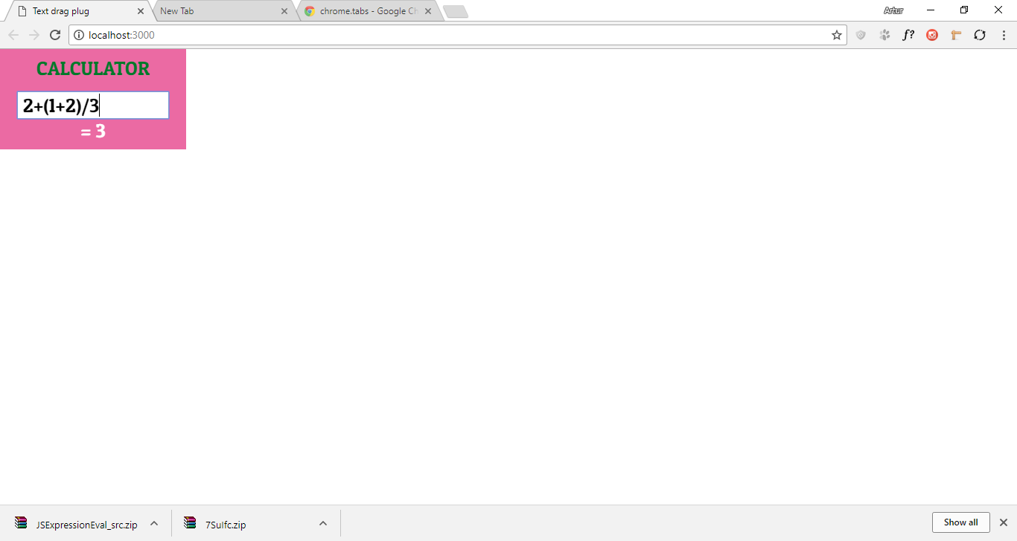
Result

Slide 8
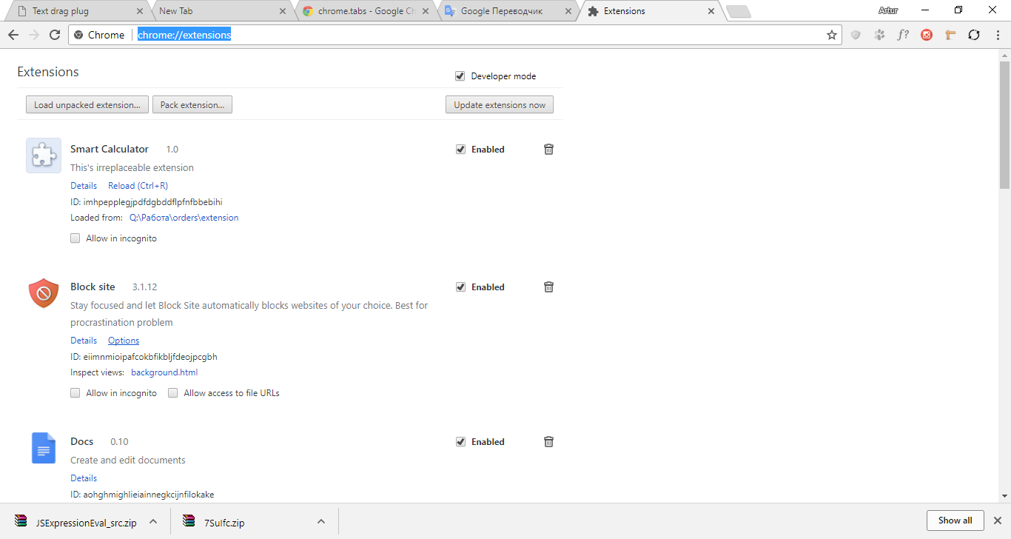
Publish extensions in the store
Go to the chrome://extensions/ and turn on developer mode.
Click ‘Load unpacked extensions’ and choose path to the folder with your project.

Slide 9
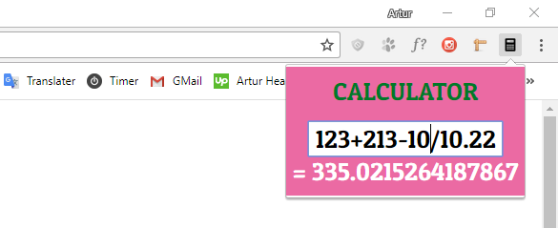
Success

Slide 10
Thank you for attention
For questions: artur.georgizov1@gmail.com

